Slide 1
World Happiness
and
Economic Strength
By
Qiaoyi Liu, Anchit Rao, Defan Ye

Slide 2
Intro to Project
Data Set:
World Happiness Report for 2016
Purpose:
Discover whether there is correlation between Economy (GDP Per Capita) and the Happiness Score

Slide 3
Context of the Data
Ranks 157 countries by their happiness levels
Report first published in 2012
Released at the United Nations at an event celebrating International Day of Happiness on March 20
The report is globally recognized by leading experts across different fields as a reference for the progress of nations

Slide 4
Data Collection
Happiness scores and rankings use data from the Gallup World Poll
Scores are based on answers to the main life evaluation question asked in the poll
Known as the Cantril ladder, asks respondents to think of a ladder with the best possible life for them being a 10 and the worst possible life being a 0
Scores are from nationally representative samples for the years 2013-2016 and use the Gallup weights to make the estimates representative

Slide 5
Why We Care
Higher income started becoming more and more significant to people
Many people contribute a lot of their attention and time on how to achieve higher income
We try to find out whether higher income, better economy can make people happier. And what are the factors that affects people’s happiness most significantly.

Slide 6
Our Hypotheses
H₀: A stronger economy results in a higher happiness score
Correlation coefficient between economy and happiness score variables is high
H_{A}: A stronger economy doesn't result in a higher happiness score
Correlation coefficient between economy and happiness score variables is low

Slide 7
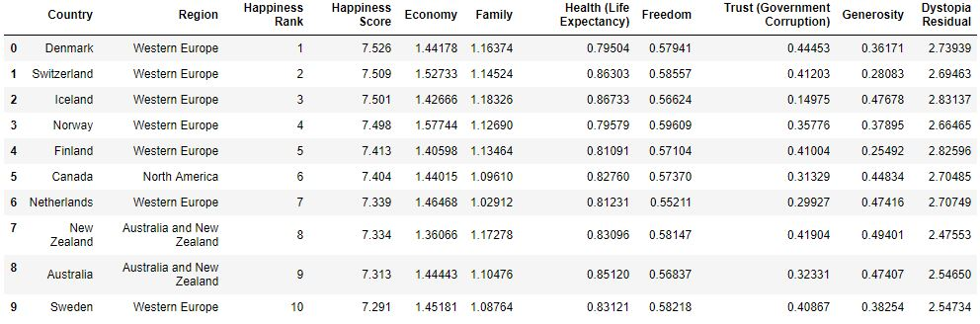
Top 10 Happiest Countries and the United States’ Rank

Slide 8
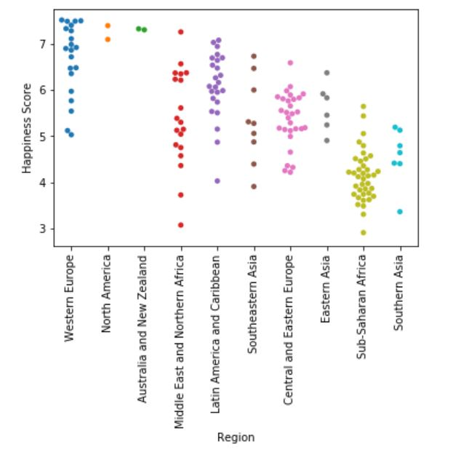
Happiness Scores by Region
Countries in Sub-Saharan Africa on average have some of the lowest happiness scores in the world
From our initial hypothesis, we can predict that countries from Sub-Saharan Africa will have weak economies.

Slide 9
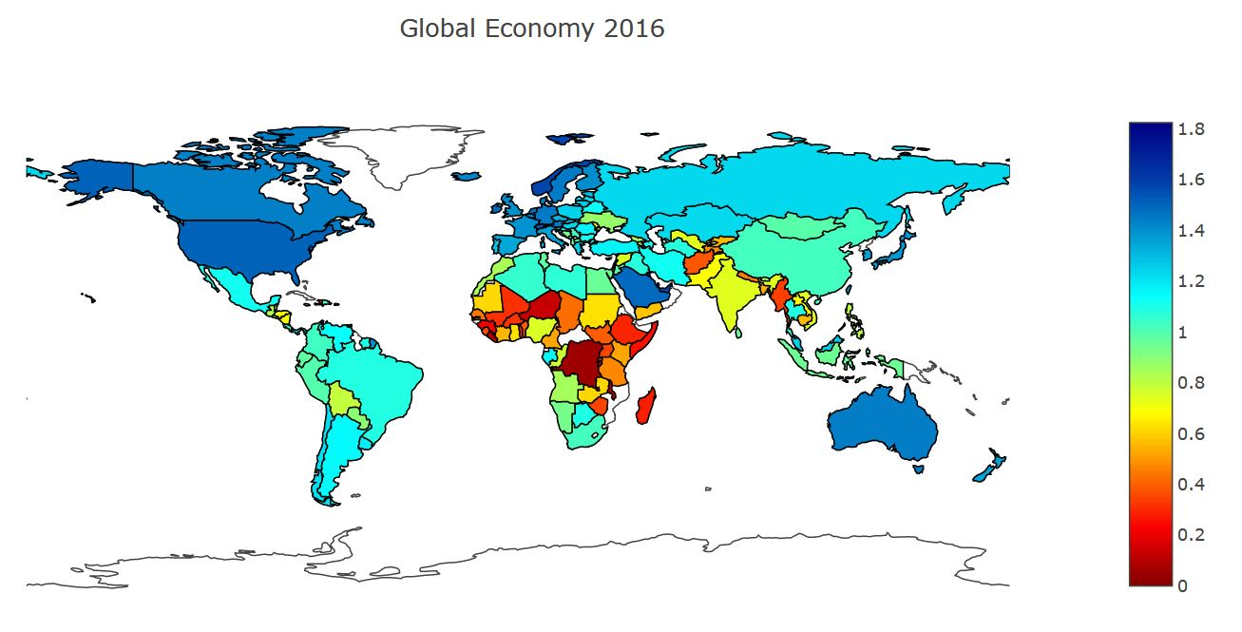
Global Heatmap for Economy (GDP Per Capita)

Slide 10
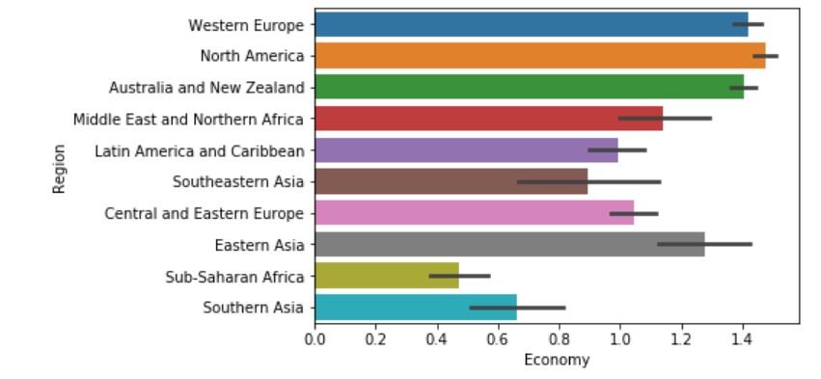
Economic Strength By Region

Slide 11
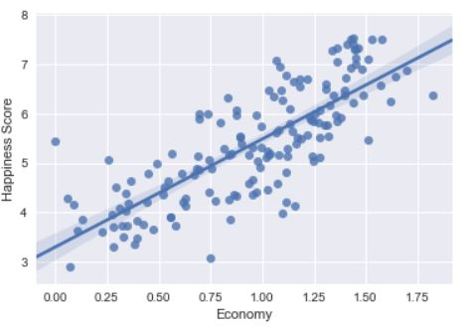
Regression Plot
Shows a strong linear correlation between Economy and Happiness Score
Positive Regression Coefficient- as Economy (GDP Per Capita) increases, so does a country’s Happiness Score

Slide 12
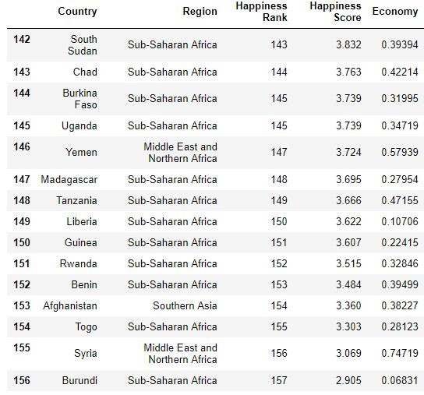
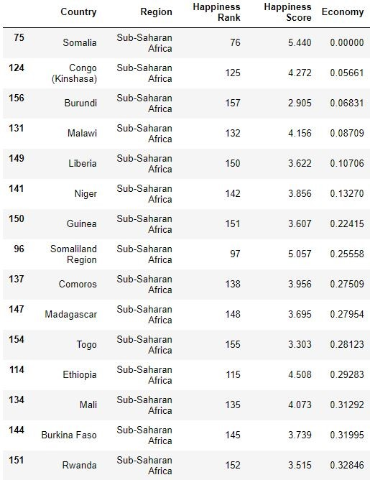
Bottom 15 Countries in Happiness vs. Economy
Happiness Scores
Economy

Slide 13
Bottom 15 Countries in Happiness vs. Economy
Happiness Scores
Economy

Slide 14
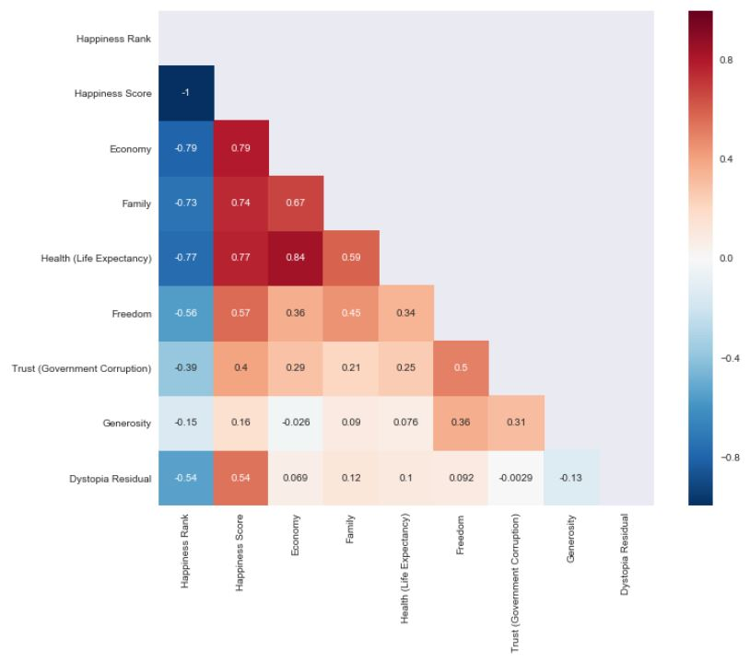

Slide 15
Result
Here were the Top 5 correlations of Happiness Score and Other Variables:
Economy --> Happiness Score| 0.79
Health (Life Expectancy) --> Happiness Score| 0.77
Family --> Happiness Score| 0.74
Freedom --> Happiness Score| 0.57
Dystopia Residual --> Happiness Score| 0.54
According to these results we have proven our initial hypothesis to be true

Slide 16
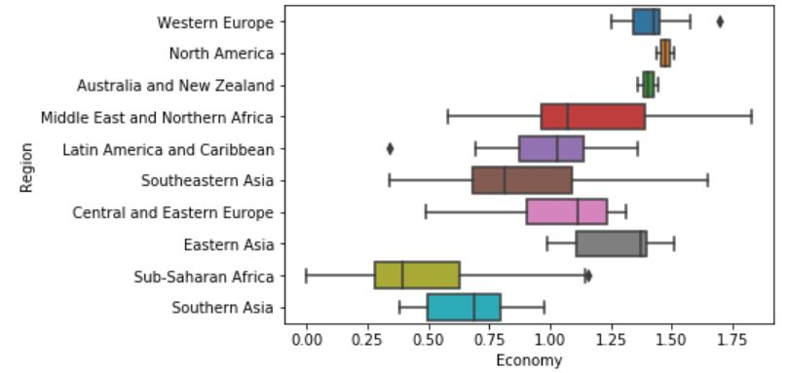
Failed Visualization

Slide 17
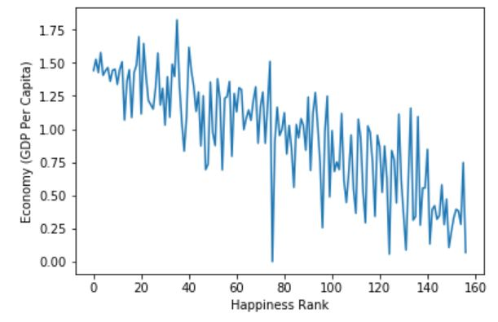
Failed Visualization 2 ( more failures T_T )

Slide 18
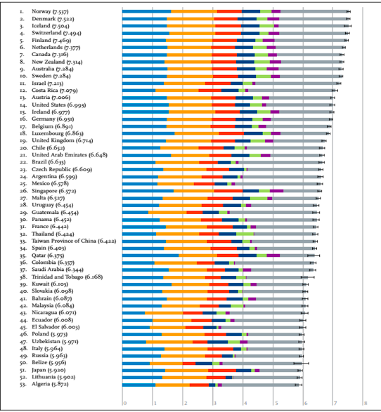
Relevant Existing Work and Visualization Techniques
Gallup, Inc. is one of the most well known non-profit groups that analyze people’s happiness.
In their report, they used Horizontal stacked bar with 6 different colors to show what six factors has taken part in happiness.
They also used linear chart and histogram graph in the report that we will consider to use to virtualize our dataset.

Slide 19

Future work
The future project or work can be determining the most important factor that lead to people’s unhappiness.

Slide 20
Reference
https://www.kaggle.com/unsdsn/world-happiness
http://worldhappiness.report/ed/2016/

